Slide 1


Initial Observations Toward Enabling Key Objectives for NFP
April 30, 2014

Slide 2
Agenda
1
An Enhanced Aditi and “Systems of Engagement”
2
NFP 360: Our Top Level Understanding
3
Enabling Key Objectives and On-boarding Blueprint
4
Team
5
Next Steps

Slide 3
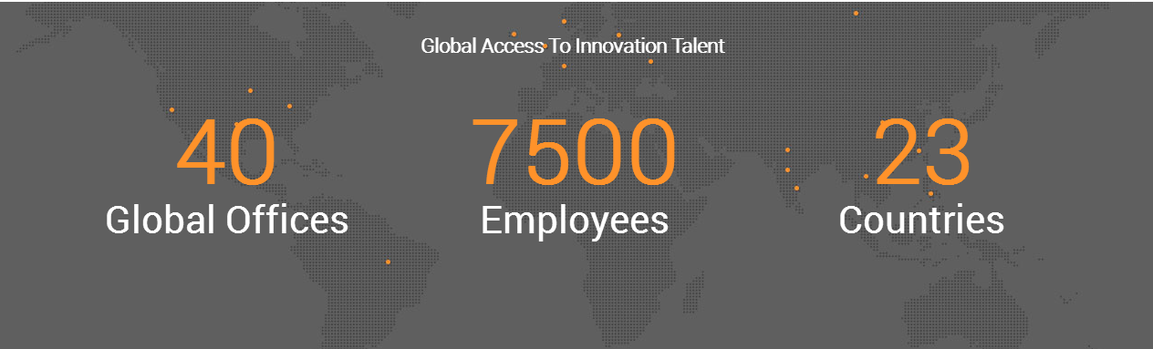
An enhanced ADITI + Symphony Teleca:
EXPANDED ACCESS TO Global talent
Buenos Aires (DC)
Boston Burlington
Chicago Detroit
Mountain View (HQ)
Nashville (DC)
New Jersey
New York
Plano
Seattle
San Diego
Westford, MA
Providence, RI
Berlin Lodz (DC)
London Malmo
Nizhy Novgorod (DC)
Nuremberg
Nuremberg
Oulu
Reading (DC)
Richmond
Rodionova
Tampere
Winchester
Bangalore (DC)
Beijing (DC)
Chengdu (DC)
Chennai (DC) Coimbatore (DC)
Gurgaon (DC)
Geyongi-do Hyderabad (DC)
Mumbai (DC)
Pune (DC)
Seoul
Tokyo

Slide 4



Our focus is Systems of engagement; CRM Is the glue
OMNI-CHANNEL
Connect the Channels
SINGLE VIEW OF CUSTOMER
Connect the Context
z
PERSONALIZATION
Connect to the Customer
SOCIAL MEDIA
MOBILE
BIG DATA
DATA QUALITY AND GOVERNANCE
MARKETING AUTOMATION
MULTICHANNEL MARKETING
WEB/ E-COMMERCE
KIOSKS
SOCIAL MEDIA ANALYTICS
PRODUCT/ PRICING ANALYTICS
SOCIAL/ MOBILE COMMERCE AND ENGAGEMENT
PREDICTIVE ANALYTICS
CONNECT THE PLATFORMS
CONNECT THE EXPERIENCES
CLOUD
API
CUSTOMER EXPERIENCE RESEARCH
INTERACTION DESIGN
VISUAL DESIGN
INFORMATION ARCHITECTURE

Slide 5
NFP 360: Our top level understanding*
CHALLENGES
Scale on-boarding of Firms cost-effectively
Increase port run-rate
Better manage Firm customizations
Improve usability of end user experience
Establish consistent Firm and end-client data within and across lines of business
Establish best possible sequence for porting/re-working legacy functionality
Create right architecture and establish governance
DESIRED GOALS
Scalable off-shore on-boarding team and streamlined solution
Data integrity across systems
Roadmap and process for identifying and managing enhancements
Manage toward an architecture and create governance team(s) to handle change management and related processes
*Based on limited discovery and input to date; would recommend additional discovery meeting with a limited set of NFP 360 team members to tighten this understanding

Slide 6
Enabling key objectives
1 – Scalable On-Boarding Blueprint
2 – Data Integrity Across Systems
3 – Roadmap for System Enhancement
4 - Architectural Guidance and Governance
Data Validation and migration (ETL)
Porting of logic (including workflow)
Customization Framework
Cost-effective (flexible pricing!)
Define, manage data flow within NFP 360 and between NFP 360 and existing systems (such as Smart Office)
Manage, improve tools/processes for monitoring data quality
Define future state of data architecture for NFP 360 and master data
Short-term enhancements including usability and visual force improvements
Roadmap for sequencing porting of features from existing systems
Architectural integration of NFP 360 into future state systems (eg. MDM)
Architecture advisory as needed
Establish right degree of governance, possibly to include:
Mgmt. of compliance (privacy)
Security processes
Problem escalation
Performance monitoring
Aditi proposes to focus initially on helping to build out a streamlined and cost-effective off-shore on-boarding process.

Slide 7
Technology options for Scaling on-boarding
1 - Onboarding Data Contract
2 - Data Validation and Compliance
3 - Intelligent Data Mapping
4 – Data Integrity
and Sync
5 - Adaptive and Business Logic Compliant UI
Define contract format (e.g. csv, webservice, RDBMS) with flexibility to define custom data attributes, enabling changes in underlying SFDC schema
Destination validation (SFDC)
Pre-loading validation (e.g. SFDC onboarding web service with data pre-load validation, rollback and return load statistics)
As Firm data is populated in Salesforce prevent duplication of existing data
Call to necessary systems build appropriate object relationships (Account, Contact, Opportunity, etc)
Define data master schema components
Define integration contracts
Build custom integration(s) (e.g. custom webservices) or leverage existing tools (e.g. commercial ETL tools)
Firms with specific business logic and/or look & feel are able to better define UI layouts (conditional field logic), business logic (e.g. XML driven UI)
Increase user adoption, enhance usability and workflow management
Reduce time and effort to onboard firms, ensure Firm data compliance, manage Firm business logic at scale.

Slide 8

on-boarding Example Solution
1 - Onboarding Data Contract
2 - Data Validation and Compliance
3 - Intelligent Data Mapping
4 – Data Integrity & Synchronization
5 - Adaptive and Business Logic Compliant UI
Firms
NFP 360 / Salesforce.com
Existing Systems
JSON message
A
Smart Office
Web Services
B
1
2
C
Data Integration & Synch
Other Existing Systems
3
4
Triggers
(account, contact, oppty, quote, custom…)
Tools may be deployed to facilitate JSON, Web services, and data integration utility
Adaptable UI
Optionally deploy UI toolkit
5
Notes:
Let us know if you want to say something Deepak ☺

Slide 9
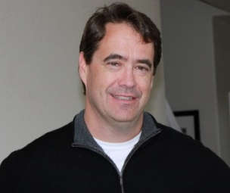


Technology Team
Brian Clift has served over the past 20 years as a architect, lead developer, independent consultant and project manager. In the most recent 7 years, Brian has served as a Salesforce.com lead developer, project manager and architect on large, complex and custom projects for companies such as Staples, Hewlett-Packard, Level 3 Communications, Motorola-Mobility, Qualcomm, Citrix and others.
Jonathan has been engaged in technology marketing, product management, and business development for over 20 years and is expert in online services business. He was a Co-Founder VP at Jobster.com; Director at eShop (acquired by Microsoft in 1996), and a Director of Product Management for 8 years at Microsoft.
Brian Clift,
Senior Salesforce
Technical Consultant
Jonathan Weinstein
Business Consultant
A multi-skilled Salesforce professional with good all-round Functional and Technical expertise. Extensive experience on Salesforce - sales cloud, service cloud and force.com platform. Recent experience with clients like Sony, Cognizant, VMWare Currently leading a approx. 20 developer Salesforce team at Sony. Led Salesforce center of excellence team at HCL, grew team from 1 to 150 member team.
Experience in End to End Implementation, Integration and Production Support. Proficient in using Apex and VisualForce. Experience in migrating data using Data Import Wizard and Data Loader. Profound knowledge in Workflow Rules, Validations and Formulas in Salesforce.
Onkar Kumar
Senior Salesforce Architect
Chandra Kanth
Salesforce Developer

Slide 10
Discussion and next steps
Feedback on NFP 360 priorities
NFP 360 team input
Firm discovery (rapid)
.

Slide 11
Web | Blog | Facebook | Twitter | LinkedIn

